Slide 1
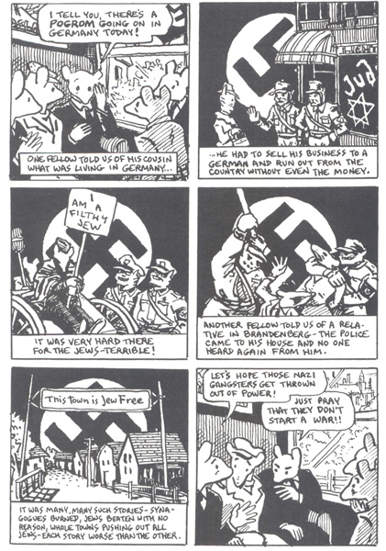
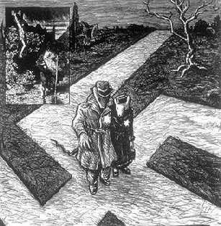
Sponge 16: Why does the artist place a swastika in the background of the panels that depict the plight of Jews in Hitler's Germany (p. 33)? Why, on page 125, is the road that Vladek and Anja travel on is also shaped like a swastika? What other symbolic devices does the author use?

Slide 2
Sponge 17
What have you learned so far about the treatment of the Jewish people at the beginning of world War II?

Slide 3
Vocabulary
Diplomatic
Taunt
Jester
Obsolete

Slide 4
Sponge 18
While most Germans disapproved of anti-Jewish violence; dislike of Jews, extended far beyond the Nazi Party faithful. Most Germans at least passively accepted discrimination against Jews.
Do you think that we passively accept discrimination against people today? Who are some of the groups who suffer passive discrimination today in Guatemala?

Slide 5
Sponge 19 Who would do such a thing?
Children were beaten against walls, or thrown alive into pits where the bodies of adults were later thrown; they were also tortured and raped. Victims of all ages often had their limbs amputated, and left to die slowly. Others were doused in petrol and set alight, or disemboweled while still alive. Yet others were shot repeatedly, or tortured and shut up alone to die in pain. The wombs of pregnant women were cut open. Women were routinely raped while being tortured.

Slide 6
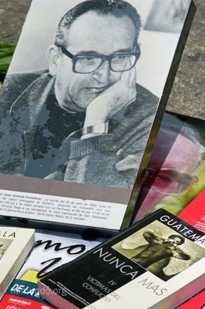
According to the Catholic Church and the United Nations: The Guatemalan Government

