Slide 1
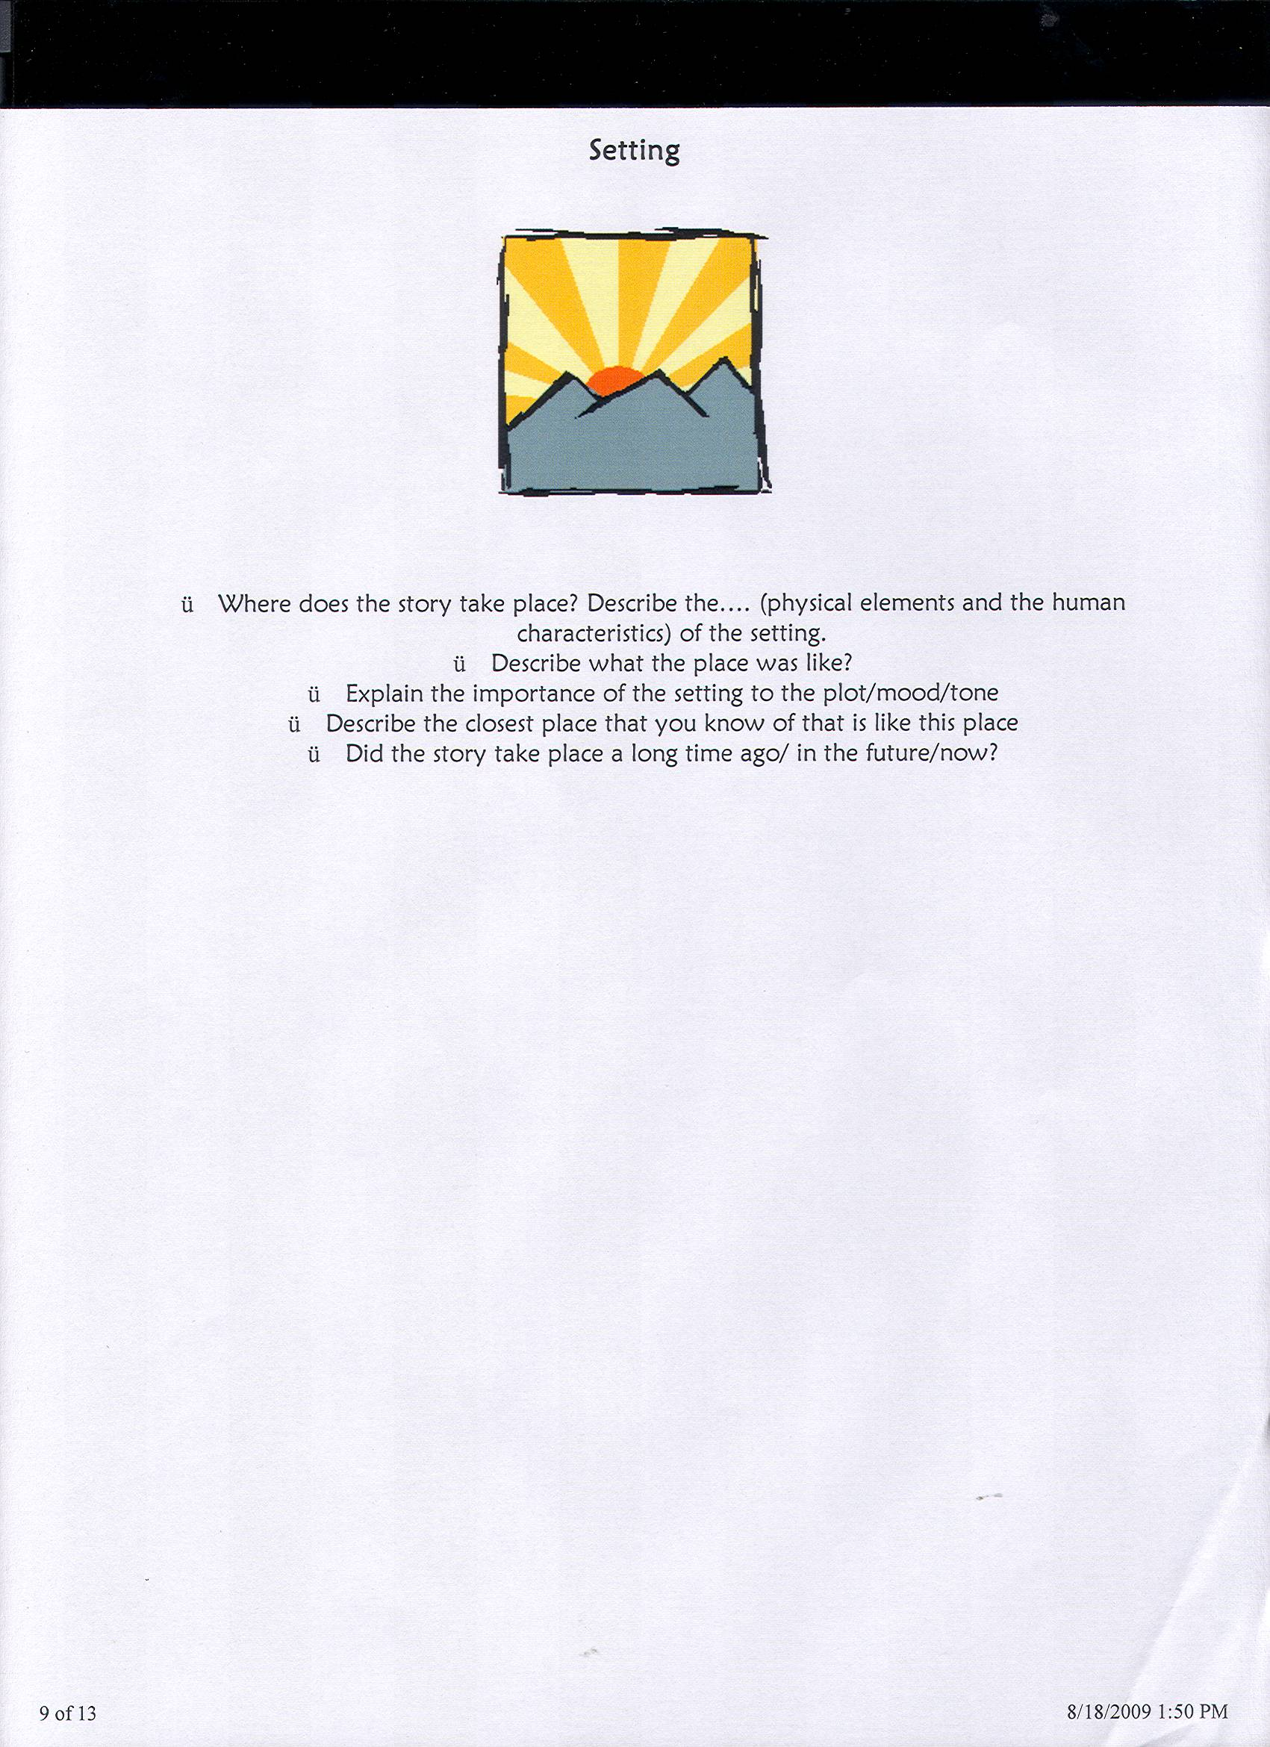

Slide 2


Slide 3
Read quietly
Thanks
On a whim Kimberly kissed a boy for the first time giving him a quizzical expression.

Slide 4
“Old Glory” by Bruce Coville
What’s the reason Donald is writing his essay?
What will the teacher, think of the essay? How do you know?
What does S.O.S. stand for?
Why did Grand-Da think the flag in his room was ridiculous?
What does Grand-Da think of Donald and his peers at school?
Name two scientific advancements or inventions that Donald’s world has that ours doesn’t.
In what two ways is Donald like kids today in our world?
Why did Grand-Da dress the way he did on his last day?
Who are ‘the Uncles?”
Why would Grand-Da be upset about the teacher leaving out a few Presidents?
Why was Donald “a little excited” while he waited for the S.O.S. men to arrive?
Why is Donald afraid to talk to his teacher?
What difficult decision does Donald make?
How does Donald feel about what he did?
Why is everyone afraid of Grand-Da?

Slide 5
Sponge 13
As a Giver, Jonas would experience a life with the best and worst of human experiences. Write one half page about what would be the best and worst part of the job?

Slide 6
“The Forecast”
By Dan Jaffe
Perhaps our age has driven us indoors.
We sprawl in the semi-darkness, dreaming sometimes
Of a vague world spinning in the wind.
But we have snapped our locks, pulled down or shades,
Taken all precautions. We shall not be disturbed.
If the earth shakes, it will be on a screen;
And if the prairie winds spills down our streets
And covers us with leaves, the weatherman will tell us.

Slide 7
Questions to ask any poem
What happens in the poem?
What is the central idea?
Is the poem symbolic? Is it allegorical?
Purpose of the poem? Message of the poem?
Who is speaking? To whom? When? Where?
What is the tone/mood of the poem?
How would you describe the language of the poem? What words especially move you?
How would you describe the imagery used in the poem? Are there examples of figurative language (similes, metaphors, personification)?

Slide 8
Sponge 14
The poem “The Forecaster” tells about a “safe” but restricted environment. Write about how this relates to your life as teenagers in Guatemala.

Slide 9
Sponge 15
Write what you know or think you know about the Holocaust and WWII.

Slide 10
Comma Quiz
1. Ivan the Terrible is considered one of the most feared people in history.
2. If you would like to travel first class Madam that will cost an extra $300.
3. Rebecca asked "Can we go to the restaurant?"
4. My best friend who comes from Egypt is a very nice guy.
5. Even if it takes all day I am going to fix the roof.
6. It seems that it will snow today because of the cold weather and red sky.
7. Japanese is food is healthy light and not very oily.
8. There was fear that another big war would start so the United Nations was formed.
9. When you meet people for the first time never talk about religion politics and a bad boss.
10. Jim wants to see a movie but Carol wants to stay home.

Slide 11
Answer: Ivan the Terrible is considered one of the most feared people in history. (NO COMMAS)
Answer: If you would like to travel first class, Madam, that will cost an extra $300.
Answer: Rebecca asked, "Can we go to the restaurant?
Answer: My best friend, who comes from Egypt, is a very nice guy.
Answer: Even if it takes all day, I am going to fix the roof.
Answer: It seems that it will snow today because of the cold weather and red sky. (NO COMMAS)
Answer: Japanese is food is healthy, light, and not very oily.
Answer: There was fear that another big war would start, so the United Nations was formed.
Answer: When you meet people for the first time, never talk about religion, politics, or a bad boss.
Answers: Jim wants to see a movie but Carol wants to stay home. -OR- Jim wants to see a movie, but Carol wants to stay home.

Slide 12
Items to Check Out
Title: any predictions, questions, clues, or connections?
Art work on Cover: any clues or guesses? possible symbolism? Predictions?
Blurb on the Back: interesting facts? descriptive words that catch your attention? Any predictions?
Blurs on the flaps:
Table of Contents: what chapter titles sound interesting?

Slide 13
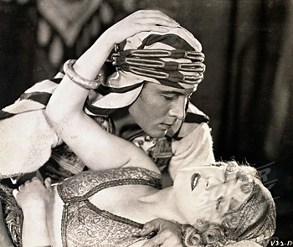
The Sheik Rudolph Valentino

Slide 14
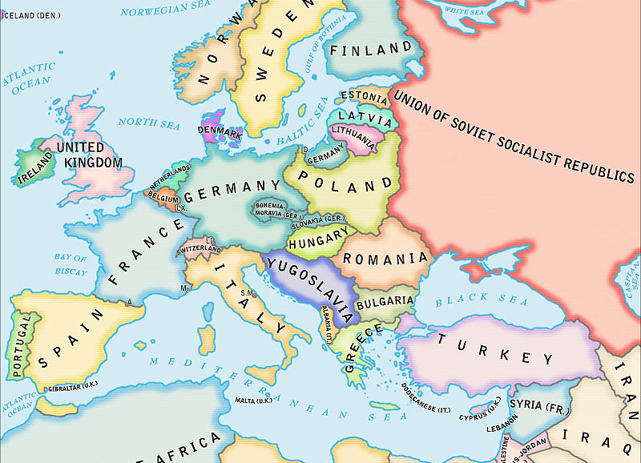

Slide 15
Vocabulary
Moderate (adj)
Fiasco (noun)
Gritty (adj)
Contemplate (verb)

